Slide 1

Oracle11g: SQL
Chapter 12
Subqueries and Merge Statements

Slide 2
Objectives
Determine when using a subquery is appropriate
Identify which clauses can contain subqueries
Distinguish between an outer query and a subquery
Use a single-row subquery in a WHERE clause
Use a single-row subquery in a HAVING clause
Use a single-row subquery in a SELECT clause
Oracle 11g: SQL

Slide 3
Objectives (continued)
Distinguish between single-row and multiple-row comparison operators
Use a multiple-row subquery in a WHERE clause
Use a multiple-row subquery in a HAVING clause
Use a multiple-column subquery in a WHERE clause
Oracle 11g: SQL

Slide 4
Objectives (continued)
Create an inline view using a multiple-column subquery in a FROM clause
Compensate for NULL values in subqueries
Distinguish between correlated and uncorrelated subqueries
Nest a subquery inside another subquery
Use a subquery in a DML action
Process multiple DML actions with a MERGE statement
Oracle 11g: SQL

Slide 5
Subqueries and Their Uses
Subquery – a query nested inside another query
Used when a query is based on an unknown value
Requires SELECT and FROM clauses
Must be enclosed in parentheses
Place on right side of comparison operator
Oracle 11g: SQL

Slide 6
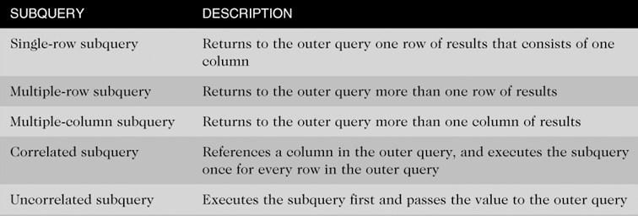
Types of Subqueries
Oracle 11g: SQL

Slide 7
Single-Row Subqueries
Can only return one result to the outer query
Operators include =, >, <, >=, <=, <>
Oracle 11g: SQL

Slide 8
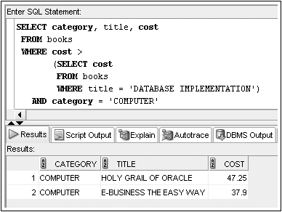
Single-Row Subquery in a WHERE Clause
Used for comparison against individual data
Oracle 11g: SQL

Slide 9
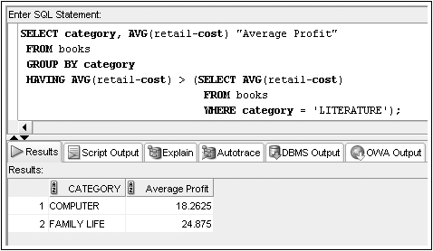
Single-Row Subquery in a HAVING Clause
Required when returned value is compared to grouped data
Oracle 11g: SQL

Slide 10
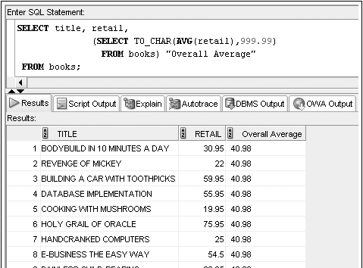
Single-Row Subquery in a SELECT Clause
Replicates subquery value for each row displayed
Oracle 11g: SQL

Slide 11
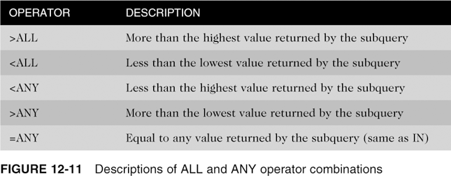
Multiple-Row Subqueries
Return more than one row of results
Require use of IN, ANY, ALL, or EXISTS operators
Oracle 11g: SQL

Slide 12
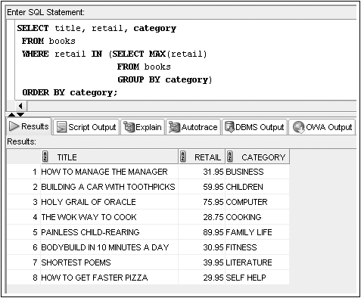
Multiple-Row Subquery in a WHERE Clause
Oracle 11g: SQL
Notes:
Find the book that has the highest retail price in each category

Slide 13
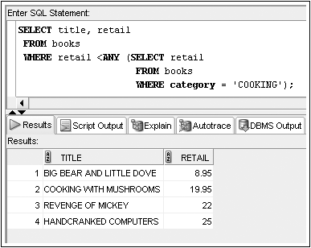
Multiple-Row Subquery in a WHERE Clause (continued)
Oracle 11g: SQL

Slide 14
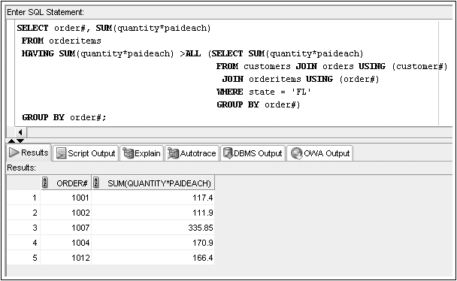
Multiple-Row Subquery in a HAVING Clause

Slide 15
Multiple-Column Subqueries
Return more than one column in results
Can return more than one row
Column list on the left side of operator must be in parentheses
Use the IN operator for WHERE and HAVING clauses
Oracle 11g: SQL

Slide 16
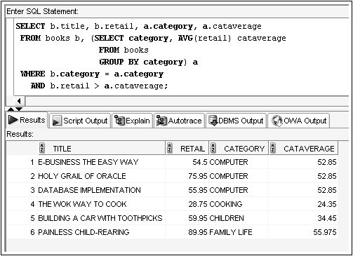
Multiple-Column Subquery in a FROM Clause
Creates a temporary table

Slide 17
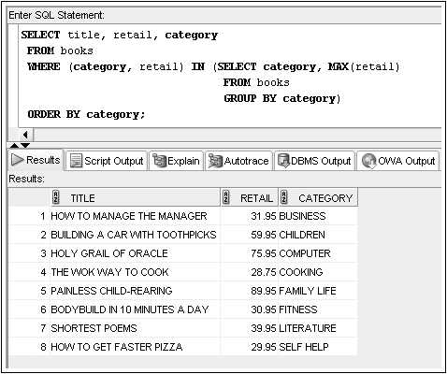
Multiple-Column Subquery in a WHERE Clause
Returns multiple columns for evaluation
Oracle 11g: SQL

Slide 18
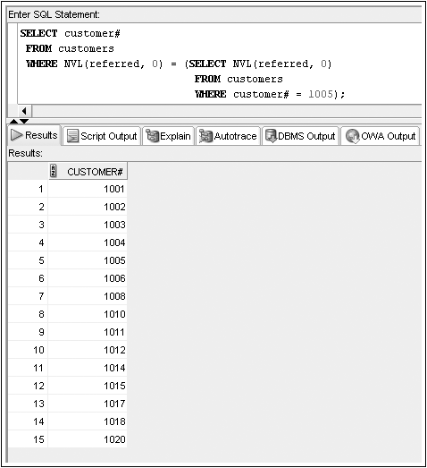
NULL Values
When a subquery might return NULL values, use NVL function
Oracle 11g: SQL

Slide 19
Uncorrelated Subqueries
Processing sequence
  Inner query is executed first
  Result is passed to outer query
  Outer query is executed
Oracle 11g: SQL

Slide 20
Correlated Subqueries
Inner query is executed once for each row processed by the outer query
Inner query references the row contained in the outer query
Oracle 11g: SQL

Slide 21
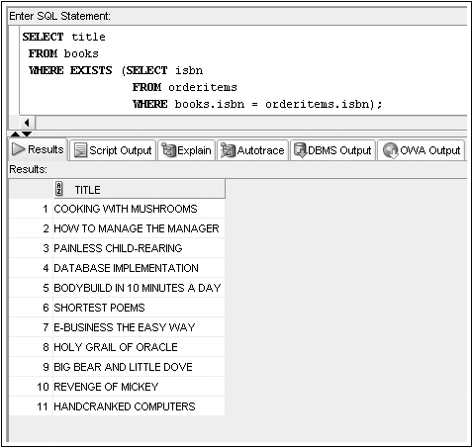
Correlated Subqueries (continued)

Slide 22
Nested Subqueries
Maximum of 255 subqueries if nested in the WHERE clause
No limit if nested in the FROM clause
Innermost subquery is resolved first, then the next level, etc.
Oracle 11g: SQL

Slide 23
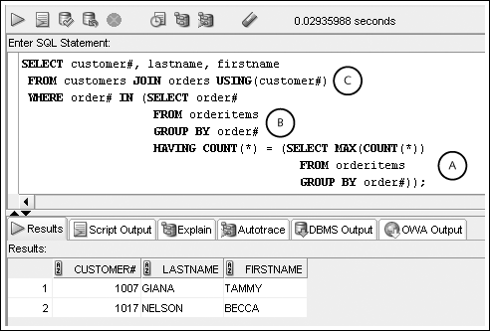
Nested Subqueries (continued)
Innermost is resolved first (A), then the second level (B), then the outer query (C)
Oracle 11g: SQL

Slide 24
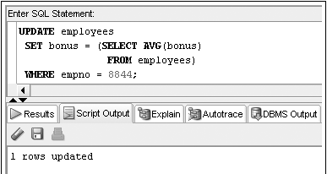
Subquery in a DML action
Oracle 11g: SQL

Slide 25
MERGE Statement
With a MERGE statement, a series of DML actions can occur with a single SQL statement
Conditionally updates one data source based on another
Oracle 11g: SQL

Slide 26
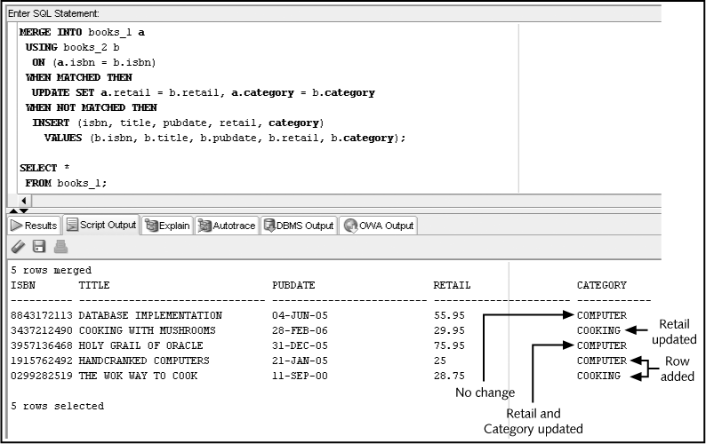

Slide 27
MERGE Statement (continued)
MERGE INTO books_1 a: The BOOKS_1 table is to be changed and a table alias of “a” is assigned to this table
USING books_2 b: The BOOKS_2 table will provide the data to update and/or insert into BOOKS_1 and a table alias of “b” is assigned to this table
ON (a.isbn = b.isbn): The rows of the two tables will be joined or matched based on isbn
WHEN MATCHED THEN: If a row match based on ISBN is discovered, execute the UPDATE action in this clause. The UPDATE action instructs the system to modify only two columns (Retail and Category)
WHEN NOT MATCHED THEN: If no match is found based on the ISBN (a books exists in BOOKS_2 that is not in BOOKS_1), then perform the INSERT action in this clause
Oracle 11g: SQL

Slide 28
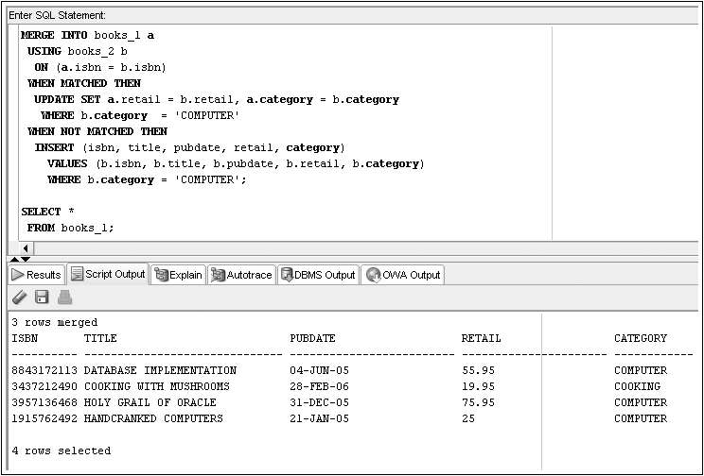
MERGE with WHERE conditions

Slide 29
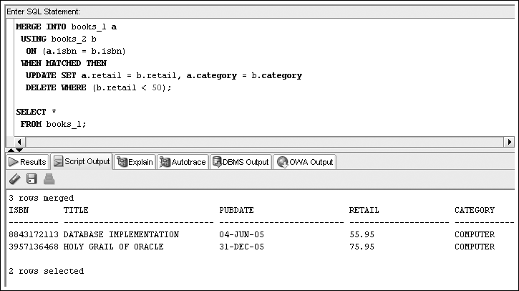
MERGE with DELETE
Oracle 11g: SQL

